Slide 1
Information Ethics as an engineering discipline lessons learned from teaching Information Ethics to 450 PhD students
Thomas Baudel, IBM France Lab & University of Paris-Saclay
Notes:
I am a research director at the IBM France Lab, working on advancing our AI products through collaborative research.
In this position, we are often confronted to the impact the technologies we develop can have on our customers, their customers, and the public at large. Over the years, we have developed training, best practices and processes to analyze and address various challenges posed by creating technology that changes the world generates.
Thus, when the doctoral school of the University of Paris Saclay needed to introduce all its doctoral students to research ethics and information ethics, the urge to share our hands-on experience came naturally, as Ethics as a discipline nurtures itself from sharing and confronting various perspectives, to build a shared understanding of how novel technologies change our world and ourselves.
But first, this is a conference focusing on the impact of AI, why is it that my talk broadens the subject to more generally Information Ethics?

Slide 2
AI Ethics as a subarea of Information Ethics
“Information Ethics is the concern for the well-being of the infosphere”
(adapted from Luciano Fioridi)
Ethical analysis is deeply contextual: what matters most is the human activity that our technology challenges. We want to categorize Information Ethics according to the activity it impacts:
Computing systems impact: cybersecurity…
Social and economic impact
  Protecting value creation, intellectual property, DRM vs. Open source…
  Freedom of expression vs containing inappropriate speech:
  internet ethics, search ethics, journalism ethics…
Human impact: privacy, physical and mental health, sense of self…
Effect on nature and the environment
Notes:
the same AI technique can be used in medical analysis to diagnose cancer, analyze social networks for marketing purposes or again to suggest a justice sentence. In each of those cases, the fundamental demands of fairness, accountability and transparency will be addressed very differently.
Conversely, a data scientist working in medicine will need to learn about bioethics, an anthropologist about HS ethics…
AI is still a tool.
-\The scientist approach vs the engineer approach: epistemic vs transformative
It makes more sense, when teaching about information ethics, to categorize topics according to the subject or activity at risk, rather than through the specific technology being used.
-\ Notice the various topics we present here are more or less set in existing frameworks of cultural practice and regulation: security, IP, privacy… have set norms that we need to respect or adapt.

Slide 3
(somewhat) Novel challenges in Information Ethics
Decision governance - governance of algorithms, governance by algorithms
Design ethics - attention capture, digital addiction…
Data science ethics – symbolic vs statistical systems, bias
(semi- &) Autonomous systems ethics
Global Information Ethics – digital divide
…
AI Ethics
Notes:
In contrast, IT present new risk areas, over which cultural norms and regulations are not stable. Those require invention, possibly trial and error, and put into question vast social and personal
AI Ethics is a blend of various concerns about human activities and technologies
Now, the issue becomes, who can best sort out the various challenges that digital technologies present us?

Slide 4
An applied Ethics, a technological Ethics
Traditionally, ethical behavior is enforced through morality and law. Yet, there are technological means to resolve ethical tensions.
Tech industries hire privacy engineers, ethicists… with an engineering background (danah boyd)
Future curriculae require engineers versed in dialectics!
Notes:
Example of the lock, a useful tool to secure privacy or private property,
Algorithms such as k-anomyzation can be used to preserve anonymity while ensuring good AI learnability
Homomorphic computation and cryptography help preserve privacy
Language theory and AI help generating explanations
‘truth by consensus’: it is difficult for STEM oriented people to accept that the right course of action is not determine by a falsifiable process.
See danah boyd

Slide 5
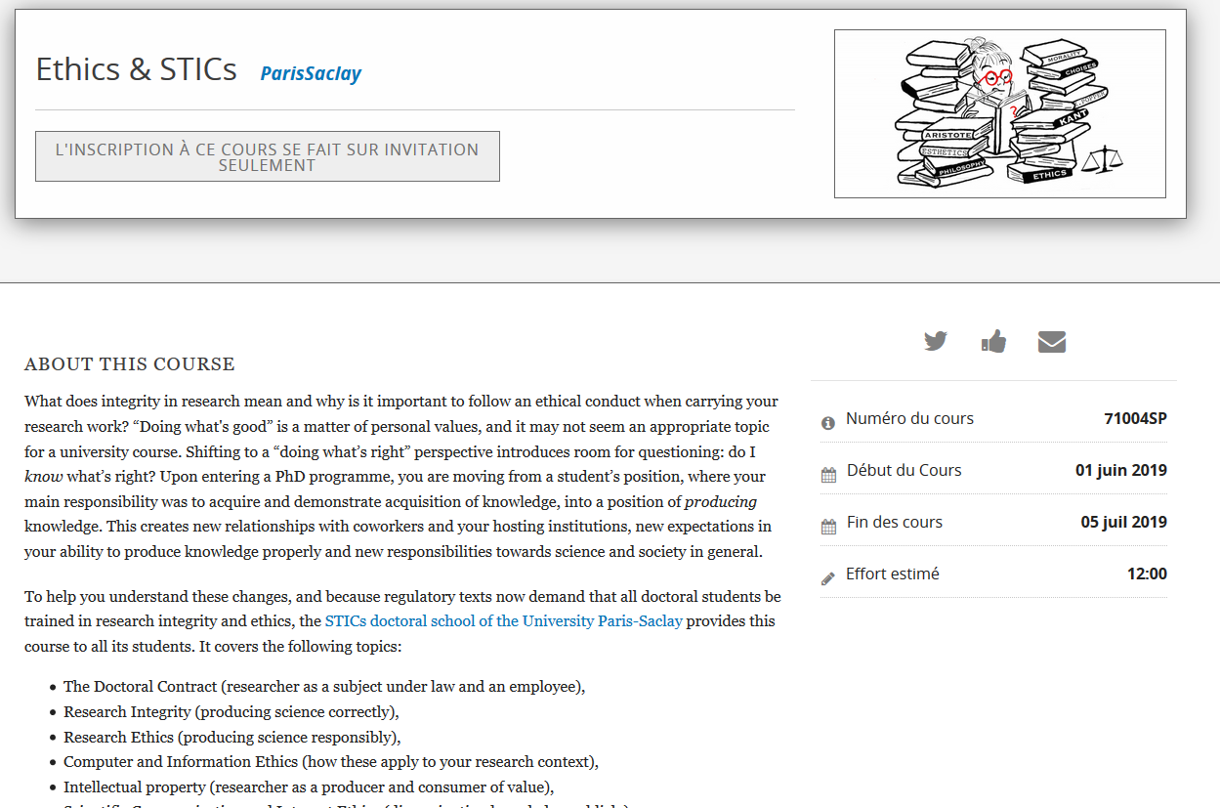
A MOOC to engage students and co-construct a shared set of ethical values and practices
Notes:
So far, we’ve had 4 sessions, 450 students take our course setup as a MOOC.
On top of a regular lecture and quizzes to assess content acquisition, we provide a discussion forum and exchanges, where much of the actual learning occurs, through discussions.
Parts of the quizzes and intentionally ambiguous and require context interpretation.

Slide 6
Some lessons learned
450 PhD students, hundreds of discussions in the forum.
  15% enthusiasts
  55% ‘appreciative’
  15% consider the subject irrelevant to their work area
  15% have trouble assimilating the content
Need to start with a conformity-based approach, to address the full public, then raise in abstraction towards ethical analysis.
Complement with discussion forum and resource center.
https://reddit.com/r/ComputerEthics

Slide 7

Intercultural Information Ethics, a vivid example

Slide 8
Towards an ontological approach of Information Ethics
According to Heidegger, our human condition is about ‘being there’: a conscious entity constrained in time and space.
In the infosphere, a computer agent is neither bound to a location nor a time frame. Our traces in the infosphere are durable and are a part of our essence.
If an ethical system is designed according to the conditions of our existence, information technologies are changing those very conditions. Hence, they force us to reconsider our approaches at Ethical analysis.
Rafael Capurro: http://www.capurro.de/oxford.html

